Slide 3
Model Parallelism
Data Parallelism
Sequential scheme
(a)
(b)
(c)

Slide 5
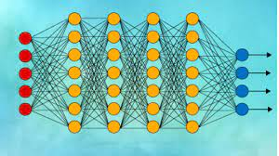
Worker 0
Optimizer
Exchange subgradient
Exchange subgradient
Worker 1
Worker m
Optimizer
Exchange subgradient
Optimizer

Slide 8
